Slide 1
Hammer CLI
G18
Rachit Rahul Das
Mihnea Popescu

Slide 2
Outline
Hammer CLI is a comprehensive auction management platform designed to serve both bidders and auctioneers through an intuitive command-line interface. The system empowers customers with intelligent bidding capabilities, featuring an innovative price estimation tool that provides data-driven insights into item valuations, helping users make informed purchasing decisions. Customers can seamlessly browse and participate in active auctions in real-time. For auctioneers, Hammer CLI streamlines auction operations by enabling efficient auction creation, providing analytics on trending items and sales performance, and offering real-time tracking of bids and winners. By combining buyer intelligence tools with robust seller management features, Hammer CLI delivers a dual-sided solution that enhances transparency and efficiency in the auction marketplace.

Slide 3
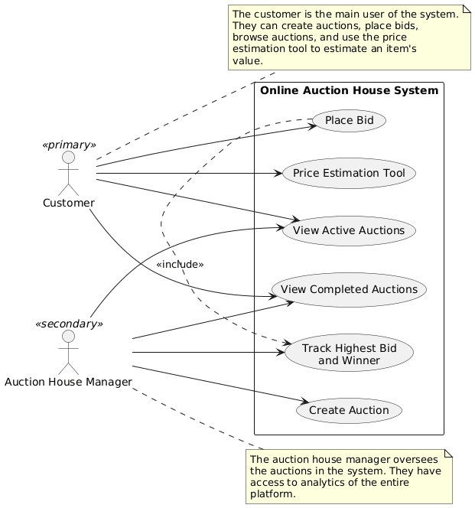
Use Case

Slide 4
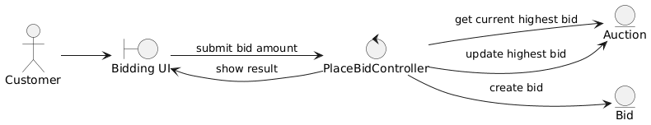
Place Bid

Slide 5
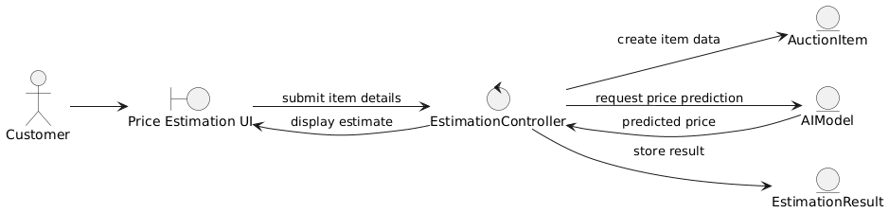
Price Estimation tool

Slide 6
View active auctions

Slide 7
View Completed Auctions

Slide 8
Track highest bidder

Slide 9
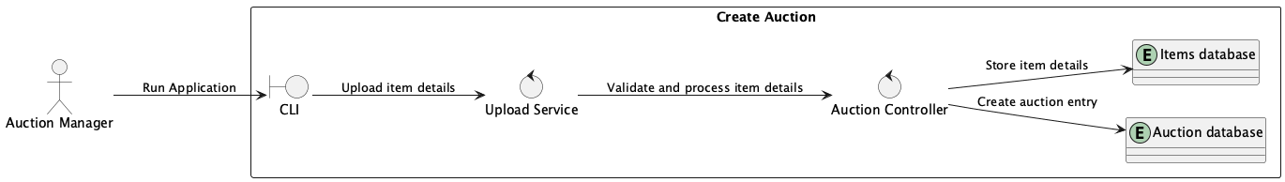
Create auction

Slide 10
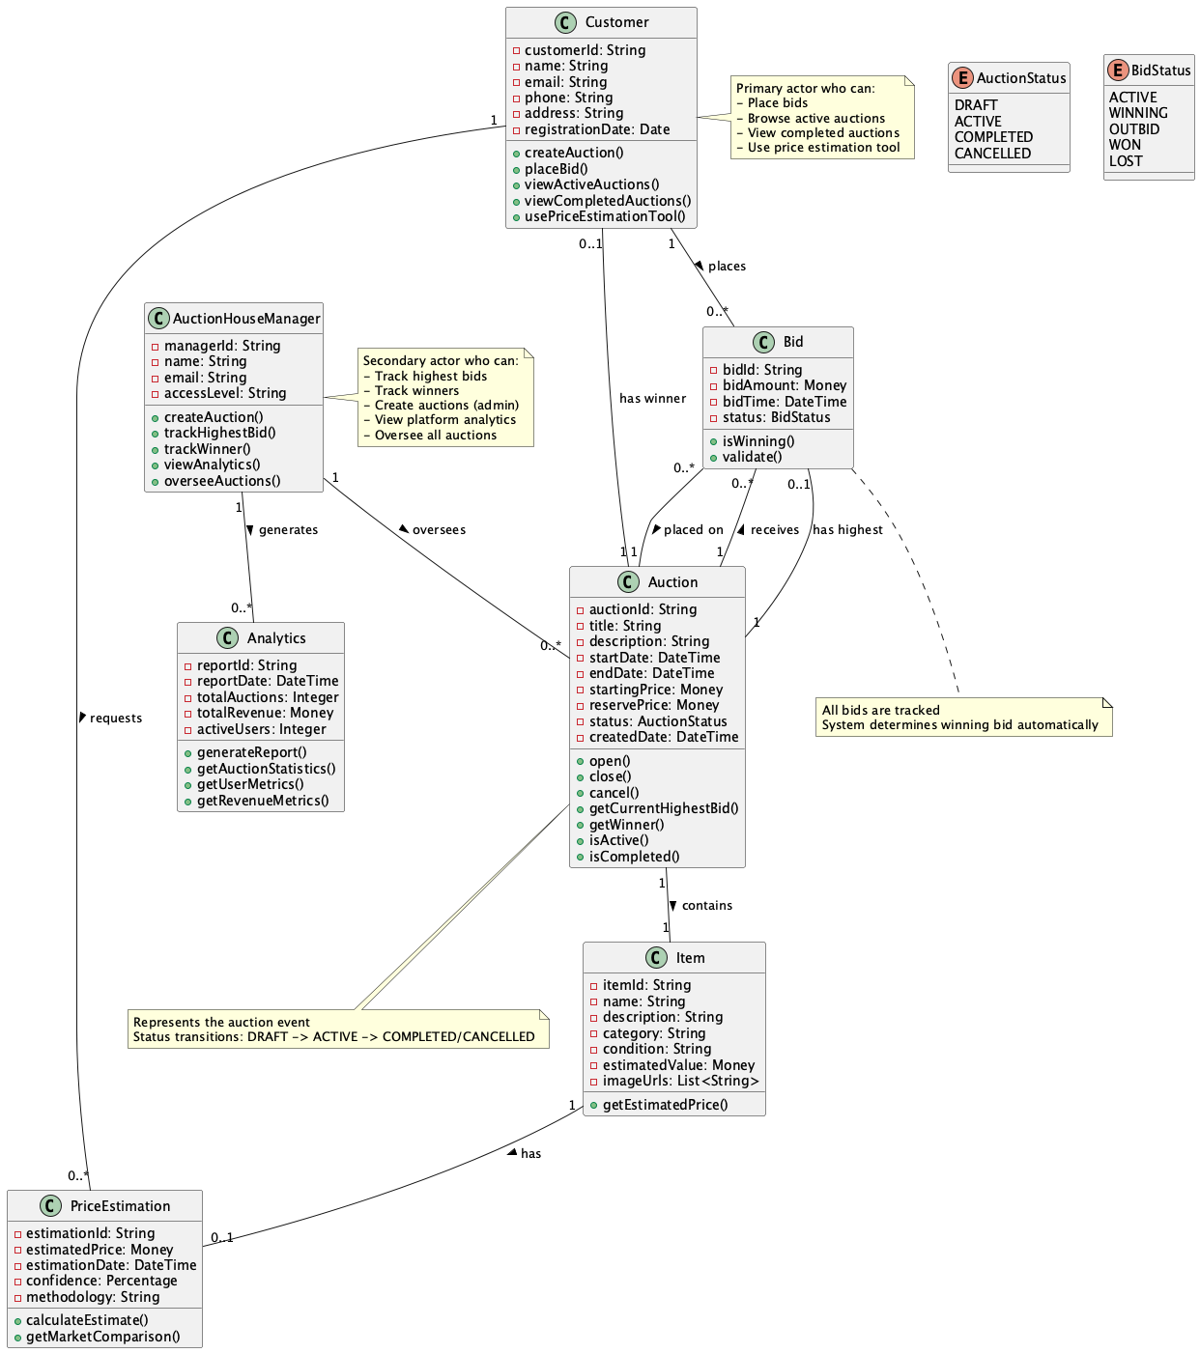
Domain Model

